Slide 1
An Approach to Facial Recognition Technology
By: Aarushi Upadhyaya, White Pd. 5

Slide 2
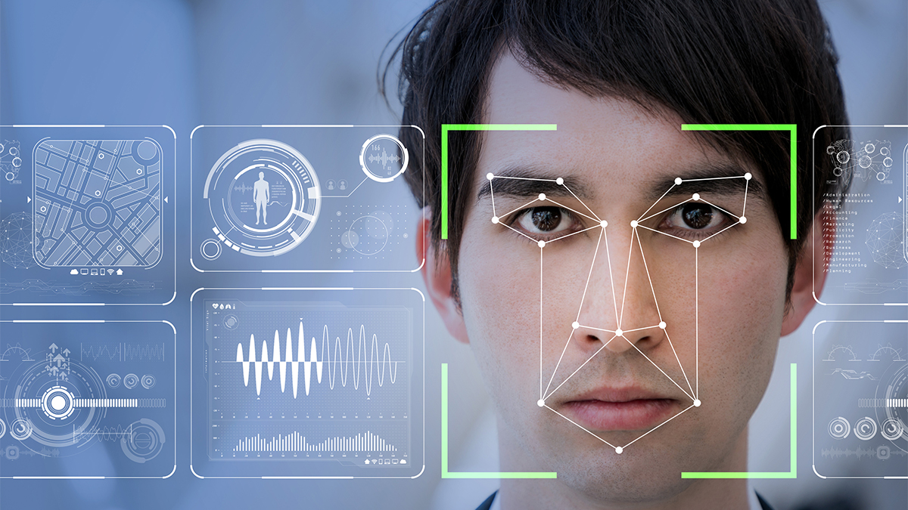

Motivation
Improvements in facial recognition technology
Potential Applications in the real world
Attendance-taking could be more efficient
Notes:
My Motivation behind this project was that facial recognition tech has improved immensely in recent years, and some facial recognition tech today even have success rates that rival that of a human. I also was interested in the numerous potential applications of it into the real world, such as a facial recognition based attendance system, and idea that i’ve been pretty interested in creating. I also thought that doing this would give me a lot of exposure to artificial intelligence concepts like CNNs, which I will talk about later, and handling image data.

Slide 3
Plan
Data used: Acquired & downloaded pictures from AT&T Labs - 40 subjects, 10 B&W photos each
Programmed in an anaconda environment
Notes:
Through my research, I was able to find the Facial recognition image database, and downloaded a picture set from AT&T Laboratories. There were 40 subjects and 10 black and white photos each. This was convenient as i didn’t need to greyscale them. Also, when I was programming the code for the facial recognition, I opted to program in an anaconda environment, as early on I faced a few issues with downloading some libraries that I needed for my method. Now onto my method...

Slide 4

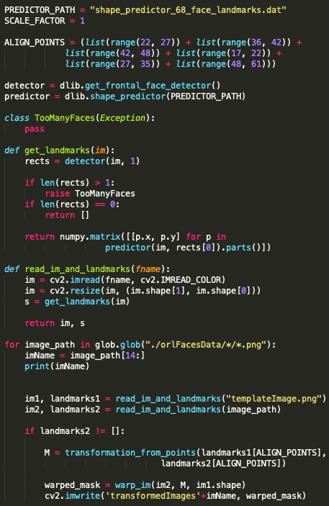
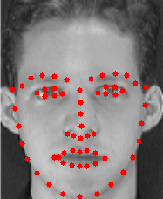
Plan
Identify key facial points
Used dlib - a Python library with image processing software
Implemented methods & facial landmark predictor
I use these points in my next step, which is ...
Notes:
The first step is to identify the key facial points, which are shown on the screen to the right. As you can see in my code snippet to the right, I used a few dblib methods, as well as implementing a facial points detector. This points are critical to the next step of my method, which is...

Slide 5

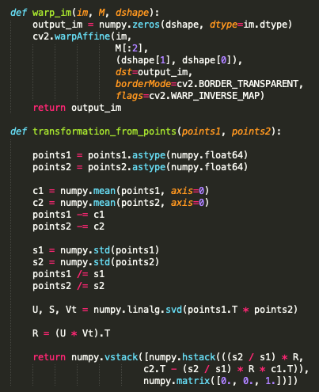
Plan/Proposal
Similarity Transform
Subtract by mean of points
Divide by Standard Deviation
Use linear algebra method Singular Value Decomposition (SVD)
Use OpenCV’s WarpAffine() to transform matrix with results from SVD
Notes:
The similarity transform. For the similarity transform, I have two images, a template image, which remains constant always, and another image, which I will be transforming to fit the template image. So the main algorithm for the similarity transform is that I take all of the key points I identified in the previous step and I take the mean and subtract it from each point. Then, I take the std of this set of points and I divide the points by the std. Then I use a method called Singular Value Decomposition, which calculates transformation factors, such as rotations, translations,and scaling and applied it to transform the image using an OpenCV method called warpAffine().

Slide 6
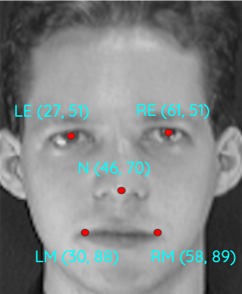
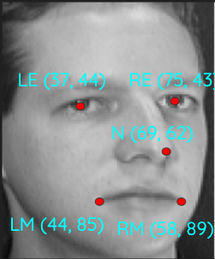
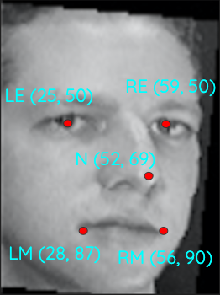
Plan
Similarity Transform contd.
Made it easier to extract patches
Template Image
Image
To be Transformed
Output
Notes:
Ok so here is an example of a transformation. The template image is your left and the image getting transformed is on your right. So, the locations of some of the key points on the faces are shown right next to the images. As you can see, the resulting image is a lot closer to the template image that it was before and there is a clear visible change. The application of the similarity transform to an image makes it much simpler to extract patches in the next step...

Slide 7
Plan
Extract patches
Chose patches to be centered around where the key points, identified by dlib were
Variance, capture different aspects of the faces
Extracted using OpenCV
Stored each patch separately, to be used in...
Notes:
So the next step is to extract patches from the images. Chose patches to be centered around where the key points, that I identified using dlib, were. I also wanted to capture different aspects of the face and focus on different key points in each. I extracted the patched using OpenCV and stored each patch separately.

Slide 8
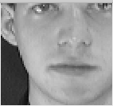
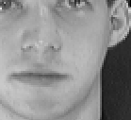
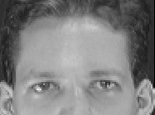
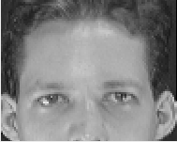
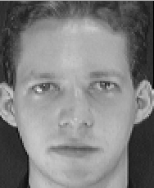
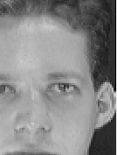
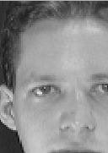
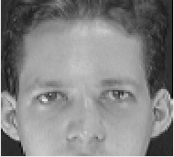
Plan
Extract patches
Notes:
Here is a picture of the patches that I extracted from the face at the bottom left

Slide 9


Plan
Convolutional Neural Networks (CNNs) confirm identity of face
What is a CNN? How does it work?
Why not just use a Neural Network?
Define Convolution Layer, Activation Layer, Flatten & Dense Layer
Notes:
Ok, sthe next step is to confirm the identity of a face using a CNN or conv neu net. So what is a CNN. A CNN is a deep learning algorithm that is similar to the human brain in that it can recieve input and analyze it, making connections through a training process. The reason I didn;t just use a neural net is bc nn’s are 2d and arent capable fo handling large images, wheras cnn’s have a 3d structure, like neurons in a brain so they are better equiped for them. So, some terms that I want to define before I continue are conv layer, in which a kernel goes through small sections of the input data and extracts the high level features from it. An activation layer, which essentially evaluates the effectiveness of teh current weight at a certain neuron. I used a relu activation or rectified linear units which very quick. A flattening layer is just a step to convert the data from 2d to 1d for the next step. And a dense layer which is also known as a fully connected layer is a layer that recieves input fron all the neurons and updates the weights.

Slide 10

Plan
CNNs confirm identity of face
Structure:
4 Convolution layers alternated with ‘Relu’ activation layers
Followed by Flatten and Dense Layer
Data: Divided 70% training 30% testing, inputted using numpy

Slide 11
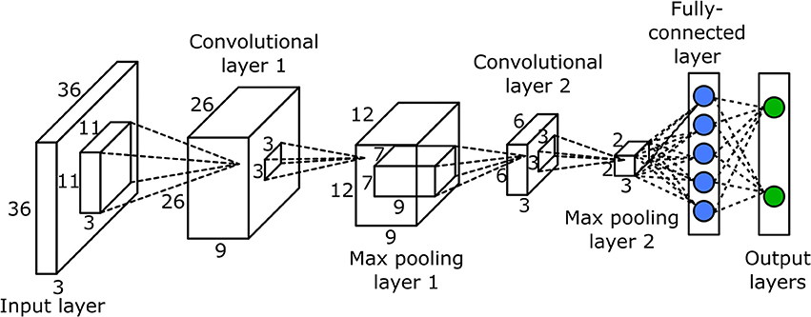
Results
Accuracy: around 75%
Compared to the average, similar
Future: improve accuracy with more data

Slide 12
Demo

Slide 13
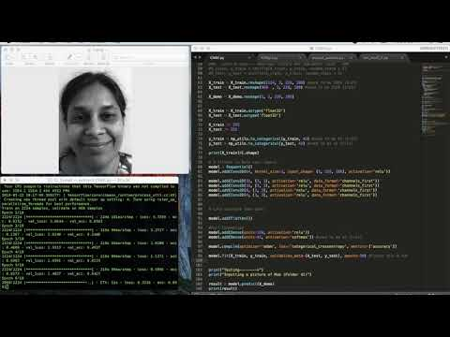
Demo
Notes:
Ok so right now, my cnn is training. Its training for 10 epochs, which means that its training 10 times. Right below each of these progress bars is the accuracy statistics, and as you can see, it goes up with each epoch. And the loss also goes down. So for this demo, i wanted to extend my tech beyond my established data, that i got from at & t labs, so I took 10 pictures of my mom, greyscaled them, made it into a folder and added it to my existing data set. So my mom is the “41st” person. I then, fed this picture of my mom into the cnn, as shown in this line (point). At the end, you can see in this list, theres a 1, and that represents the identity of the face that the CNN thinks. so , here the 1 is in teh index that corresponds to the 41st person, which is my Mom! So i just added in some code that reaffirms that the CNN identifies the picture as my Mom!

Slide 14
Real-World Applications
Already being used
iPhone X
Social Media automatic tagging
Mastercard’s plan for online biometric payment
Future Applications
My original purpose: A facial recognition-based attendance system
Notes:
There are numerous very useful applications of facial recognition tech. Many of you may not realize it, but we facial recognition tech is already incorporated into our daily lives. Some of these are, in the iPhone X, which uses facial recognition instead of a password. There’s also Facebook’s automatic tagging in pictures. There’s also Mastercard’s plan to fully integrate its cards so that users can pay with their face when shopping online. In addition, there are many future applications, which could have the power to revolutionize our society, but the one application that I originally set out to accomplish and which I mentioned at he beginning of this presentation, a facial recognition based attendance system.

Slide 15
Questions?
Notes:
Any questions?

Slide 16
Thank you!
Notes:
Thank you!

